Slide 1
Strategies for Publishing Your Community-Engaged Scholarship
Diane M. Doberneck, Ph.D., connordm@msu.edu
Director for Faculty and Professional Development
Office for Public Engagement and Scholarship
Adjunct Associate Professor Department of Community Sustainability
Michigan State University
Emerging Engagement Scholars Workshop, Athens, GA
Master class #4, 2022
Notes:
Session Timetable:
10 mins: what RPT is and how it works
20 mins: how to prepare your materials
--importance of narrative—both RPT essay & other place you promote your narrative

Slide 2
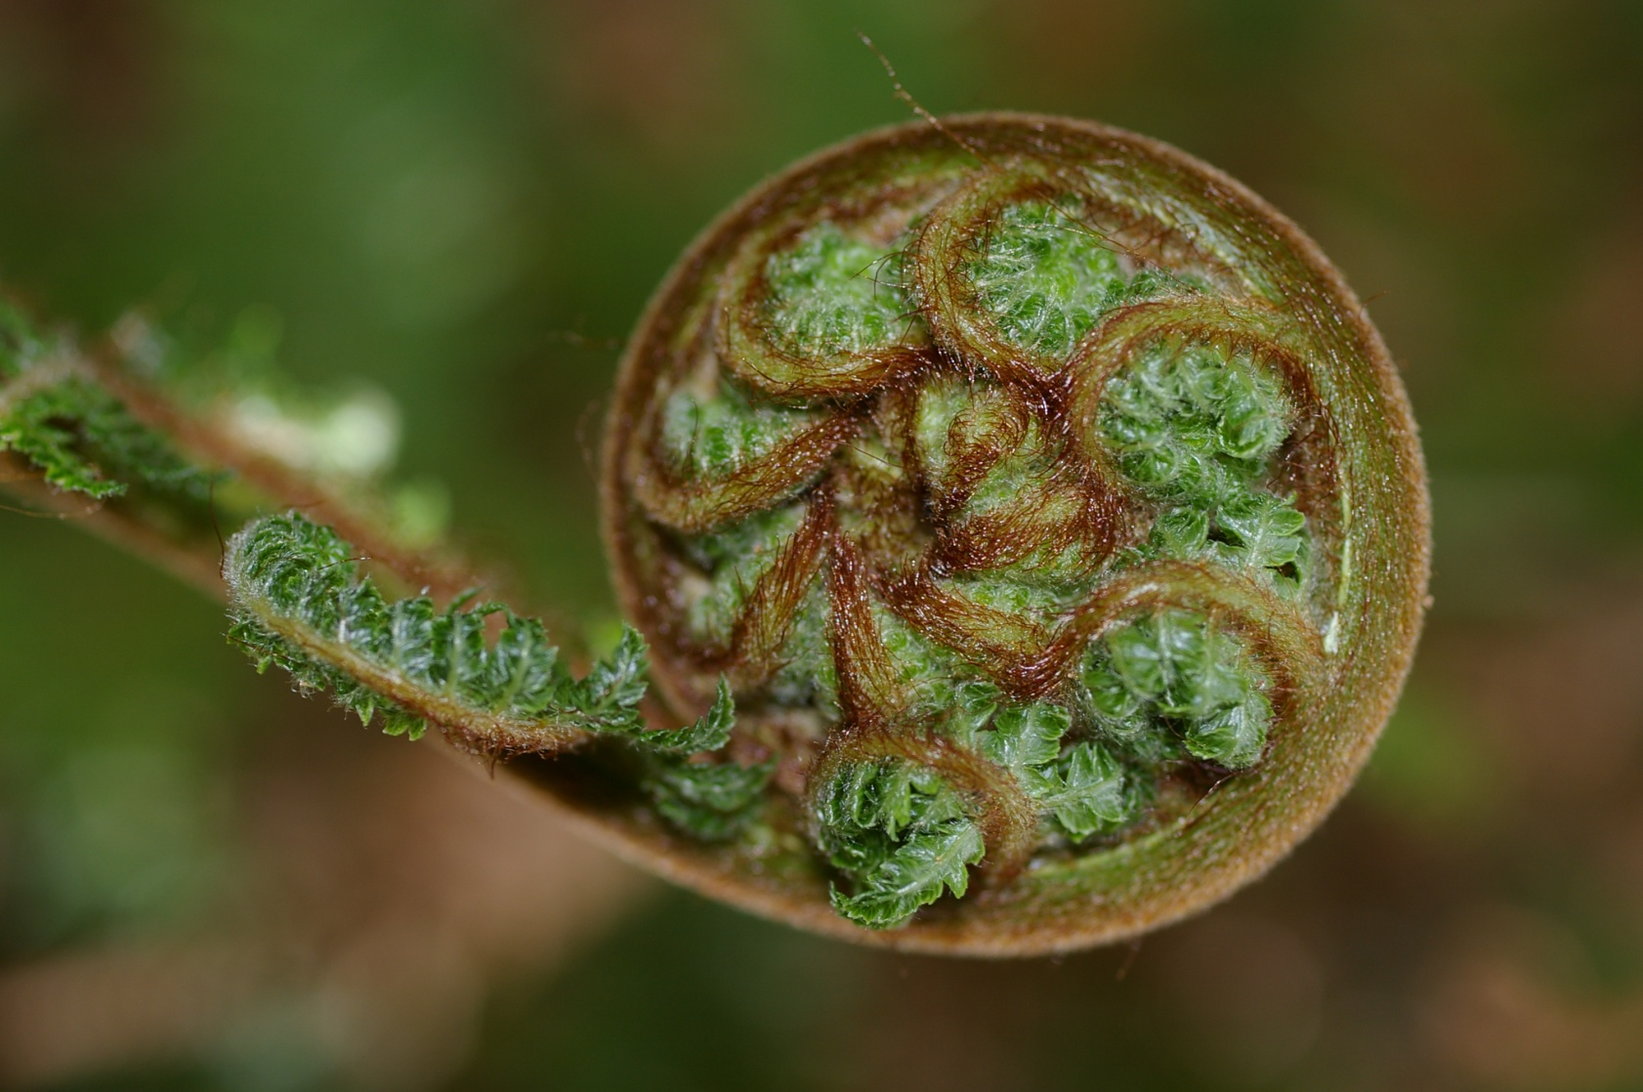
IDENTIFY YOUR LEAST PUBLISHABLE UNITS
Whitney J. Owen “In defense of the least publishable unit” Chronicle of Higher Education, February 6, 2004.
Notes:
Pause, stand up, stretch, really stretch out big and tall and wide.
Speaker Notes:
Least publishable unit (LPU)
Cynical
Lots of little ones, but no big one
Alternative, builds confidence, more possible in the early juggle
Work/life balance
Image from:
https://www.google.com/search?q=image+fern+unfurling&biw=1280&bih=913&tbm=isch&tbo=u&source=univ&sa=X&ved=0CB0QsARqFQoTCLyZrdLT9MYCFQHOgAodT98BZw#tbm=isch&tbs=rimg%3ACfF2pcnzTIlRIjhiH_1Azwmt7hqF7x2LITHfmyQBDvn6fKd2-aavjjs6wcmQUZXXhjTd-zKj_16Vl85dAeNFHcLaDjGSoSCWIf8DPCa3uGEdkEOk9vNSjeKhIJoXvHYshMd-YR4CGktRNS8dEqEgnJAEO-fp8p3RFh9aN8cteOTyoSCb5pq-OOzrByETqDqTI0wjoEKhIJZBRldeGNN34R6XoL2gJ8c7AqEgnMqP_1pWXzl0BEqOx7Inh4U9CoSCR40UdwtoOMZEfAcDHxQHMwU&q=image%20fern%20unfurling&imgrc=8XalyfNMiVEvoM%3A

Slide 3
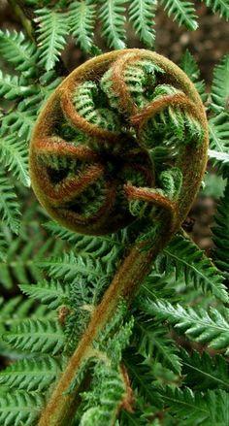
Unfurling Your Project or Experience
Conceptual framework, paradigm, program theory, or models.
Methods, processes, partnership, engagement.
Program descriptions, case studies.
Findings, results or impacts on
  Community.
  Community partners.
  Students.
  Faculty and staff.
  Partnership.
  Institution.
Critical reflections on the experience, process, critiques, or lessons learned.
Notes:
Image from:
https://www.google.com/search?q=image+fern+unfurling&biw=1280&bih=913&tbm=isch&tbo=u&source=univ&sa=X&ved=0CB0QsARqFQoTCLyZrdLT9MYCFQHOgAodT98BZw#tbm=isch&tbs=rimg%3ACfF2pcnzTIlRIjhiH_1Azwmt7hqF7x2LITHfmyQBDvn6fKd2-aavjjs6wcmQUZXXhjTd-zKj_16Vl85dAeNFHcLaDjGSoSCWIf8DPCa3uGEdkEOk9vNSjeKhIJoXvHYshMd-YR4CGktRNS8dEqEgnJAEO-fp8p3RFh9aN8cteOTyoSCb5pq-OOzrByETqDqTI0wjoEKhIJZBRldeGNN34R6XoL2gJ8c7AqEgnMqP_1pWXzl0BEqOx7Inh4U9CoSCR40UdwtoOMZEfAcDHxQHMwU&q=image%20fern%20unfurling&imgrc=UKvVtEwi8707gM%3A

Slide 4
Unfurling Your CES Project Worksheet
(Doberneck & Carmichael, 2020)
Topic | Sub-Audience | Type of Article | Potential Journals or Academic Conferences | Potential Public or Practitioner Products
 | Disciplinary Research Teaching & Learning Methods Community-Engaged Scholarship | Conceptual framework, program theory, models Program description, case study Methods or processes for partnership or engagement Results or Impacts on community students faculty organization institution Reflections: critiques, lessons learned
 | Interdisciplinary Research Teaching & Learning Methods Community-Engaged Scholarship

Slide 5
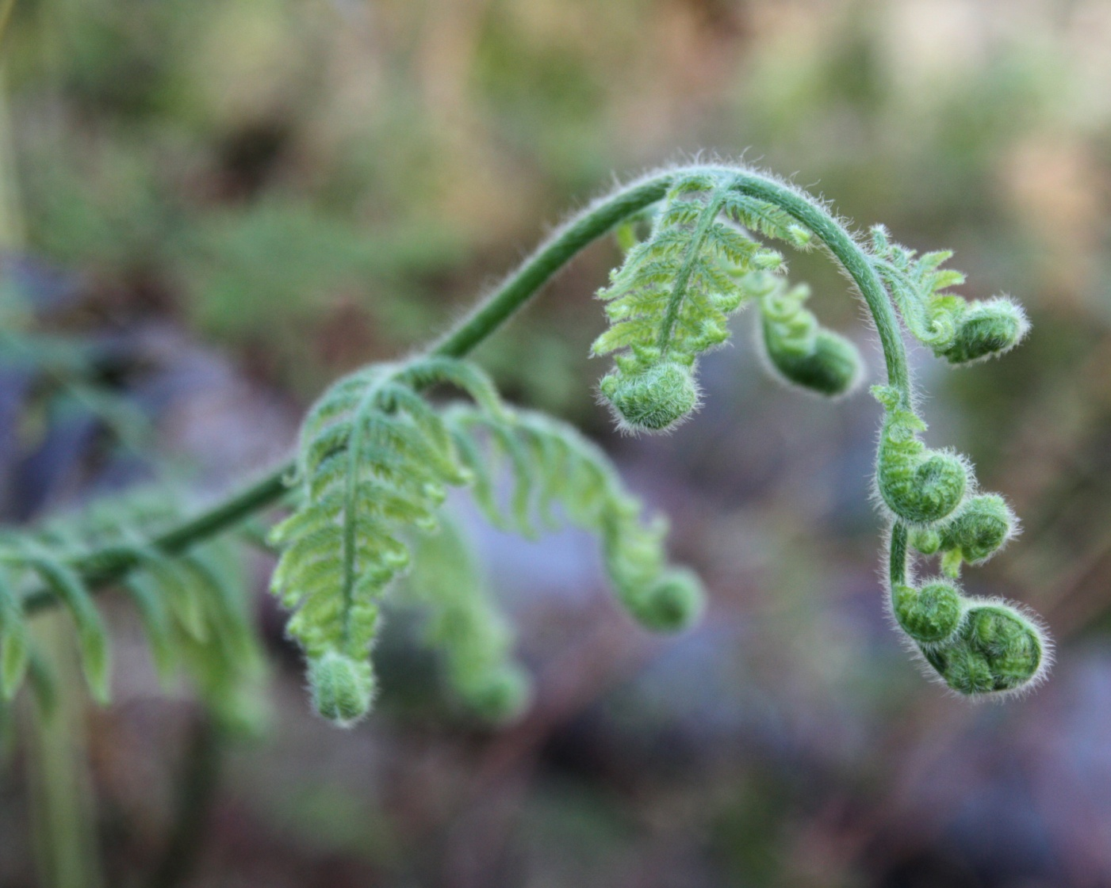
Franz’s “How Farmers Learn” Project
Journal article—Disciplinary Journal
Findings, results, impacts
Franz, N. (2010). How farmers learn: Implications for Agricultural Educators. Journal of Rural Social Sciences, 25(1), 37-59.
Journal article—Community Engagement Journal
Findings, results, impacts—Research Brief
Franz, N. (2010). Farmer, Agent, and Specialist Perspectives on Preferences for Learning Among Today’s Farmers. Journal of Extension, 48(3).
Journal article—Methods Journal
Critical reflections
Piercy, F.P., Franz, N., Donaldson, J.L., & Richard, R. F. (2011). Consistency and change in participatory action research: Reflection on a focus group study about how farmers learn. The Qualitative Report, 16(3), 820-829.

Slide 6
Franz’s Unfurling “How Farmers Learn”
Topic | Sub-Audience | Type of Article | Potential Journals
How famers learn: implications for agricultural education | Discipline Research | Results, impacts, findings | Journal of Rural Social Sciences
Farmer, agent, and specialist perspectives on preferences for learning among today’s farmers | Interdisciplinary Research | Research Brief | Journal of Extension
Consistency and change in participatory action research: Reflection on a focus group study about how famers learn | Interdisciplinary Methods | Reflections | The Qualitative Report

Slide 7
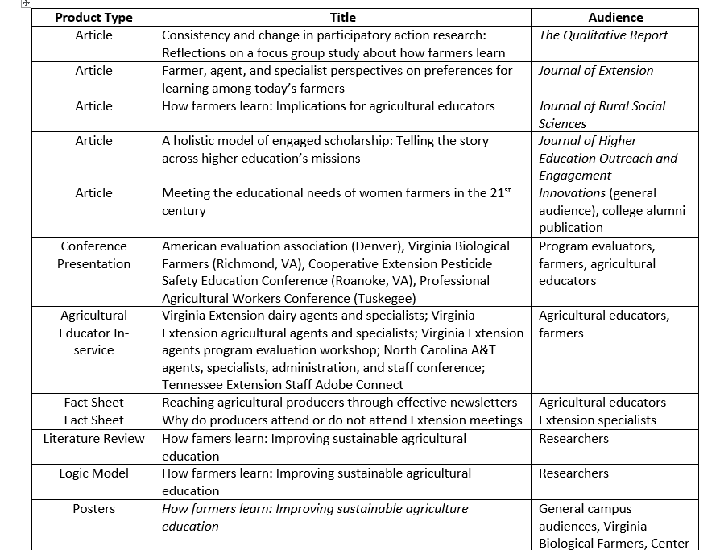
Franz—Academic & Public Products Example

Slide 8
Christine Carmichael at Fair Forests Consulting, https://fairforests.com/
Graduate Work
Carmichael, C. (2017). The trouble with the trees? Social and political dynamics of greening efforts in Detroit, MI. Dissertation. Dept. of Forestry. Michigan State University.
Carmichael, C. (2017). Community-engaged research on tree planting in Detroit, Michigan: Lessons on race, intersectionality, and identity. Graduate Certification in Community Engagement Portfolio.
Journal Article—Disciplinary Journal
Carmichael, C., & McDonough, M. H. (2018). The trouble with the trees? Social and political dynamics of street tree-planting efforts in Detroit, MI. Urban Forestry & Urban Greening 31, 221-229.
Carmichael, C., & McDonough, M.H. (2019). Community stories: Explaining resistance to street tree-planting programs in Detroit, MI, USA. Society and Natural Resources.

Slide 9
Carmichael’s Unfurling “Trouble with the Trees”
Topic | Audience | Type of Article | Potential Journals
The trouble with trees? Social & political dynamics of greening efforts of Detroit, MI | Disciplinary | Dissertation
Community-engaged research on tree planting in Detroit, MI: Lessons learned on race, intersectionality, and identity | Interdisciplinary CES | Community-engaged scholarship | Graduate Certification in Community Engagement Portfolio
The trouble with the trees? Social & political dynamics of street tree-planning efforts in Detroit, MI, USA | Disciplinary Research | Results | Urban Forestry & Urban Greening
Community stories: Explaining resistance to street tree planning programs in Detroit, MI, USA | Interdisciplinary Research | Results | Society & Natural Resources

Slide 10
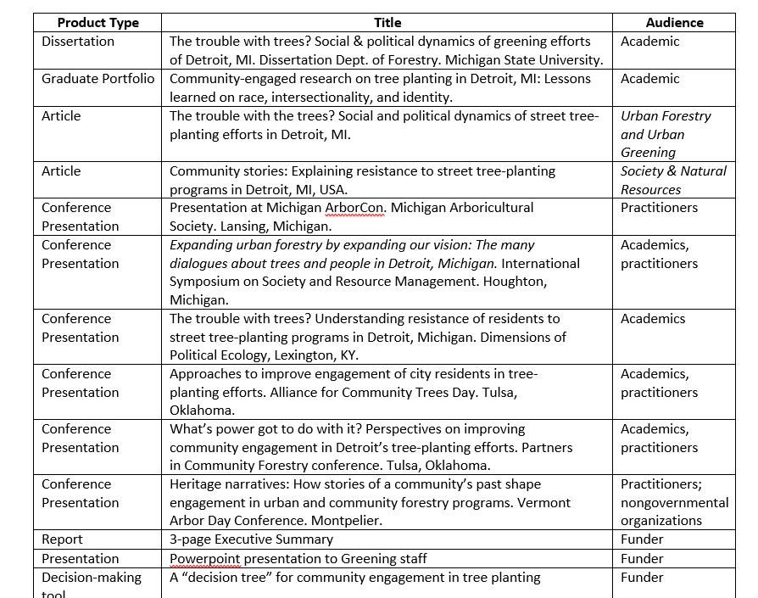
Carmichael Academic & Public Products Example

Slide 11
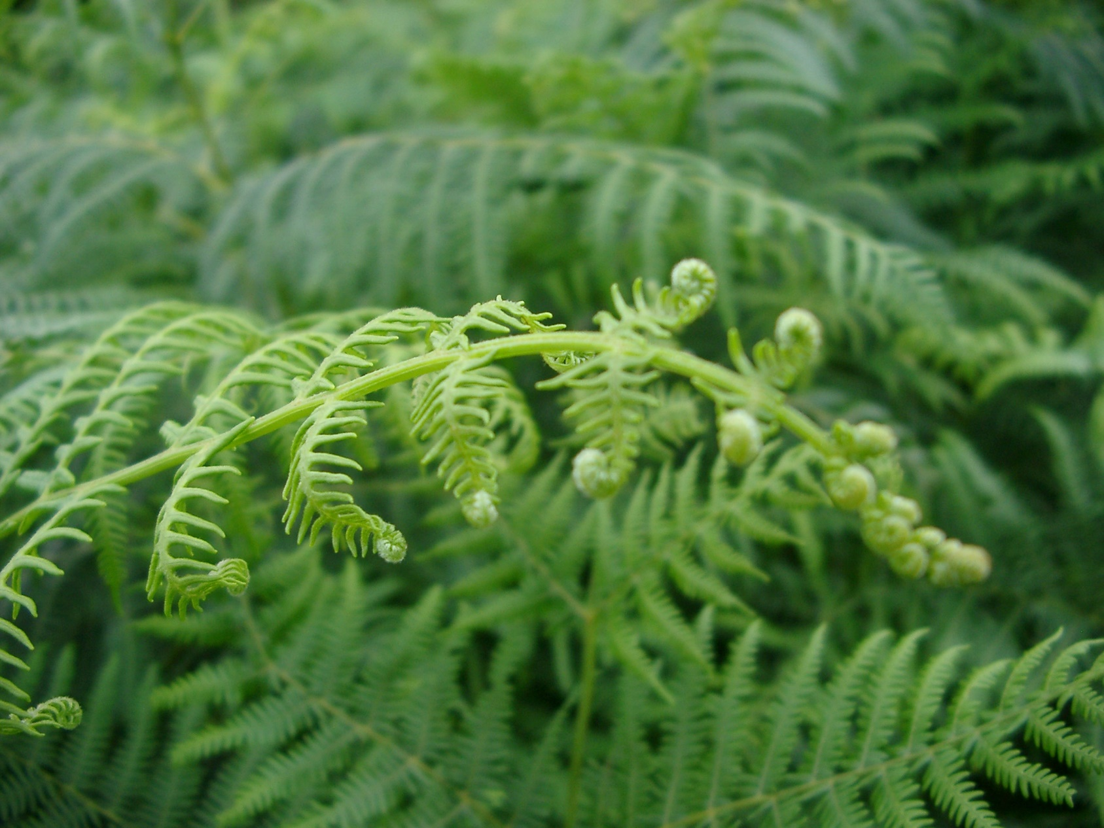
Ready to Unfurl Your Own Project ?
Notes:
Image from: https://www.google.com/search?q=image+fern+fronds&biw=1280&bih=913&tbm=isch&tbo=u&source=univ&sa=X&ved=0CB0QsARqFQoTCO2T78jU9MYCFceTDQoda-wDXw#imgrc=_JfjMYZgEmeKoM:

Slide 12
Practice Unfurling a Project
What kinds of articles might you write?
  Conceptual framework, paradigm, program theory, or models
  Methods, processes, partnership, engagement
  Program descriptions, case studies
  Findings, results or impacts
  Critical reflections on the experience, process, critiques, or lessons learned
What kinds of journals might you publish those articles in? Which academic conferences might you present at?
  Disciplinary journals
  Scholarship of teaching and learning (SoTL) journals in your discipline
  Interdisciplinary scholarship of teaching and learning journals
  Research, evaluation, or methods journals
  Community engagement journals in your discipline
  Interdisciplinary community engagement journals

Slide 13
What kinds of public products might you produce? What practitioner, public, or community audiences do you hope to reach? What is their (not your) preferred format?
  Blog post
  Policy brief
  POD cast, TED talk
  Curriculum guidebook
  Infographic
  What else?

Slide 14
Unfurling Your CES Project Worksheet
(Doberneck & Carmichael, 2020)
Topic | Sub-Audience | Type of Article | Potential Journals or Academic Conferences | Potential Public or Practitioner Products
 | Disciplinary Research Teaching & Learning Methods Community-Engaged Scholarship | Conceptual framework, program theory, models Program description, case study Methods or processes for partnership or engagement Results or Impacts on community students faculty organization institution Reflections: critiques, lessons learned
 | Interdisciplinary Research Teaching & Learning Methods Community-Engaged Scholarship

Slide 15
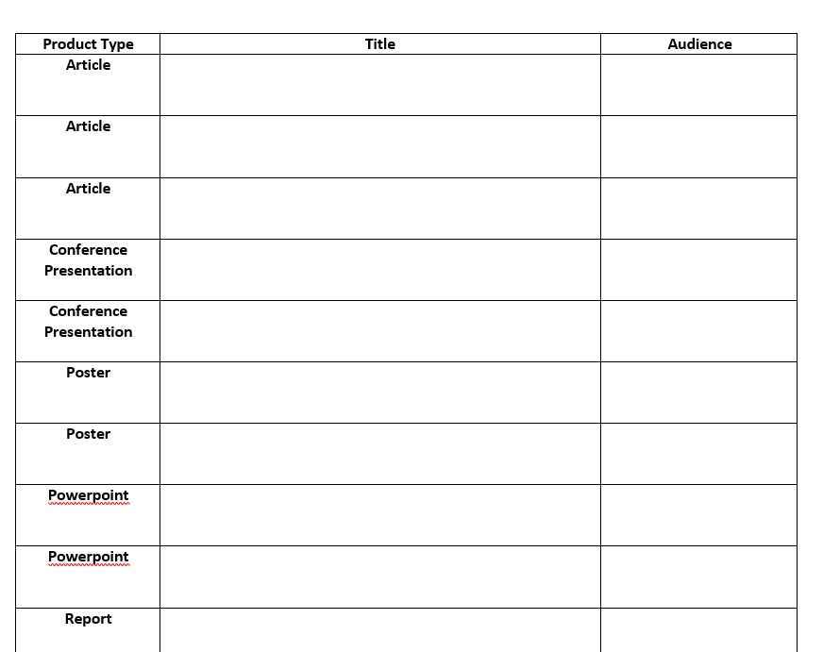
Activity ≠ Accomplishments

Slide 16



Prioritize After You Unfurl
What is low hanging fruit—easiest to get published quickly?
What are you most passionate about?
What is a breakthrough idea/significant contribution?
What “counts” for you?
  Peer reviewed journal articles-which ones?
  Chapters in edited volumes ?
  Books?
Where will it count the most?
  Advice from senior mentors vs.
  Advice from recently tenured colleagues

Slide 17
What Journal “Fits” Your Work
Where would you publish your next piece? Why does that choice make sense?
If you are tenure track, talk with your departmental mentors about “what counts,” especially tier one journals with high impact factors.
If you are not tenure track, talk with your mentors about what they recommend….and what journals you would like to publish in.
  They are very likely unfamiliar with the wide ranges of choices now available for those who can publish in interdisciplinary community engagement journals!!
  Be your own advocate.

Slide 18
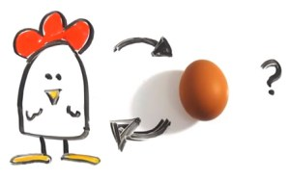
Which Comes First—
The Journal? or the Manuscript?
Notes:
NOTE: You should select the journal BEFORE you write the manuscript b/c manuscripts have different word counts, different sections, different length of those sections, reference lengths, and overall formats.
Writing a manuscript first….and then shopping around for a journal often wastes time…due to longer, longer revisions.
Image from: https://www.google.com/search?q=chicken+or+egg+first&source=lnms&tbm=isch&sa=X&ved=0ahUKEwjck4DgisLaAhXNuFkKHafTAesQ_AUICygC&biw=1366&bih=662#imgrc=7EvHEdzIlzxhrM:

Slide 19
Locating Potential Journals
Consider your why. If your why influences your community-engaged teaching and learning or community-engaged research, then turn to foundational scholarship related to it.
Consider your type of CES. What is the foundational scholarship related to it? Who are the main theorists? What are conceptual models? How are they being incorporated into your work?
Consider your discipline. What are the important questions in your field? Are you addressing them through your community engagement activities?
Who is a leading scholar in your field who is doing community-engaged scholarship? What foundational scholarship does that person rely upon? What does their c.v. tell you? Where are they publishing?
Notes:
Tell them that this is a super important slide

Slide 20
Ex: Use Your Why to Identify Journals
Why
Student Learning
Education, Citizenship, and Social Justice
Equity & Excellence in Education
Social Justice
Social Justice Research

Slide 21
Ex: Use Your Why to Identify Journals
Why
Food Security/ Urban Gardens
Agriculture & Human Values
J/Hunger & Environmental Nutrition
Social Justice
Social Justice Research
J of Community Practice

Slide 22
Ex: Use Type of CES to Identify Journals
CE Research
Health
Health Promotion Practice
Participatory Action Methodologies
Action Research
Progress in Community Health Partnerships: Research, Education, and Action

Slide 23
Ex: Use CES Type—Creative Activities
CE Creative Activities
Public: Arts, Design, Humanities
Journal of Art for Life
Community Arts Journal

Slide 24
Ex: Use CES Type to Identify Journals
Service Learning
Michigan Journal of Community Service Learning
Reflections: Journal of Public Rhetoric, Civic Writing, and Service Learning
International Journal of Service Learning in Engineering, Humanitarian Engineering, and Social Entrepreneurship

Slide 25
Ex: Use CES Type—Non-formal Ed Journals
CE Non Formal Education
STEM
International Science Education, Part B Communication and Engagement
Youth
Visitor Education
Public Understanding of Science
Journal of STEM Outreach

Slide 26
Ex: Use Your Discipline to Identify Journals
Anthropology
Collaborative Anthropologies
Practicing Anthropology
Anthropology in Action

Slide 27
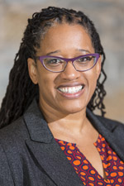
Ex: Following a Leading Scholar’s Lead
Tania Mitchell
Journals
Diversity and democracy
Journal of Higher Education Outreach and Engagement
Michigan Journal of Community Service Learning
Theory Into Practice
Journal of Critical Thought and Praxis
Equity and Excellence in Education
http://www.cehd.umn.edu/olpd/people/tmitchel/

Slide 28
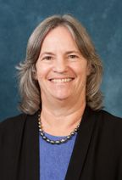
Ex: Following a Leading Scholar’s Lead
Barbara Israel
Journals
Health Education Quarterly
American Journal of Community Psychology
Praxis III: Voices in Dialogue
Health, Education & Behavior
Annual Review of Public Health
https://sph.umich.edu/faculty-profiles/israel-barbara.html

Slide 29
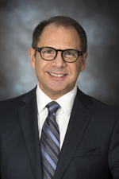
Ex: Following a Leading Scholar’s Lead
Andy Furco
Journals
British Journal of Educational Studies
Citizenship Education
Michigan Journal of Community Service Learning
Journal of Public Affairs
Journal of Cooperative Education
Journal of Adolescence
http://www.cehd.umn.edu/olpd/people/afurco/

Slide 30

Ex: Following a Leading Scholar https://www.profmarkreed.com/journal-articles-books

Slide 31
Interdisciplinary Community Engagement Journals
Tools
Annotated List—details number of issues/year, number of articles/issue; submission details. If you are strategizing on how to get an article published quickly, this list should help you.
Journal Section Comparison Table—cross-walks journal titles with article type. If you know what type of article you’d like to write, you can shop for a journal using this table.

Slide 32
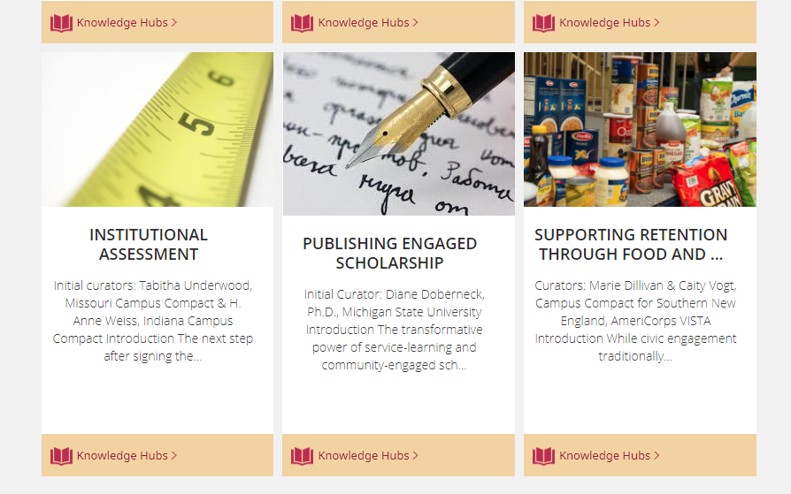
Campus Compact Knowledge Hub https://compact.org/resource-posts/publishing-engaged-scholarship/

Slide 33
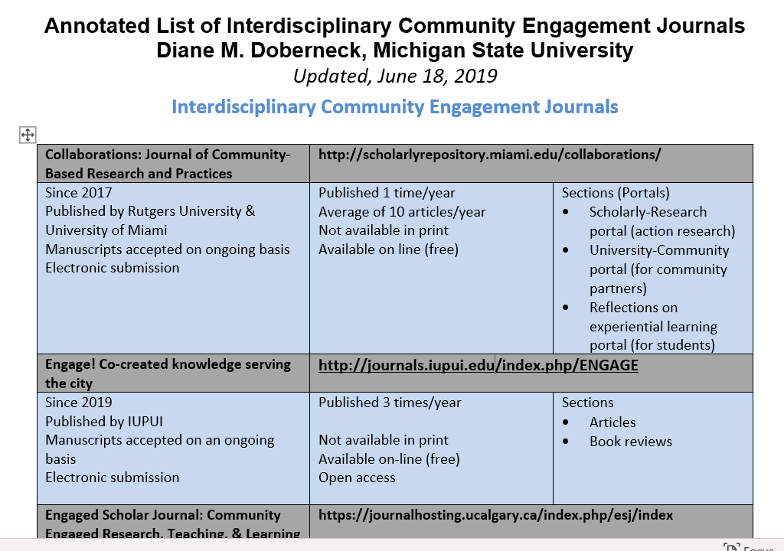
Notes:
Handout

Slide 34
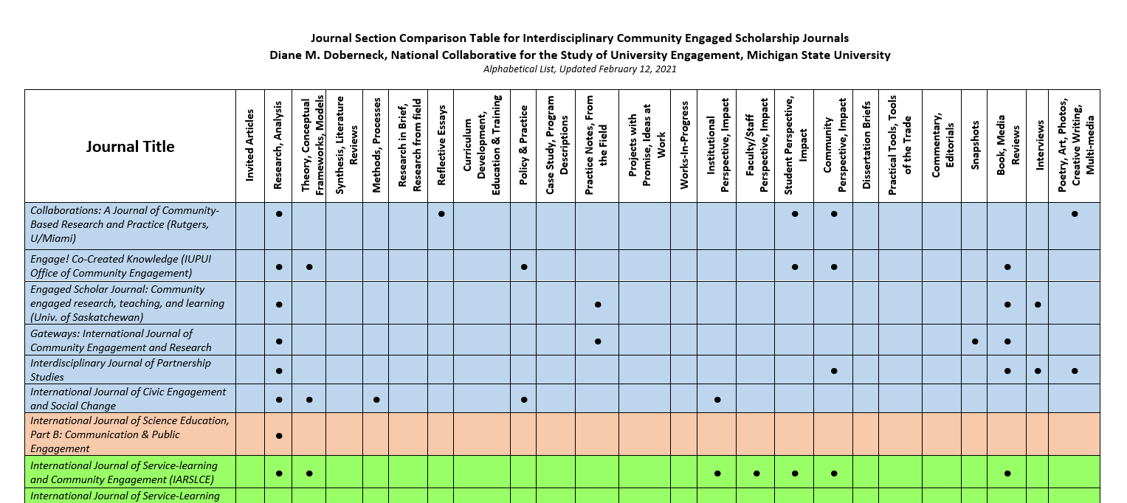
Journal Section Comparison Table

Slide 35

Pause to Reflect
What are new three ideas about publishing your CES?
What would be next action steps related to them?
How might you use EESW and ESC 2022 to strengthen your network, establish a mutual cheering group, develop strategies for career success?

Slide 36
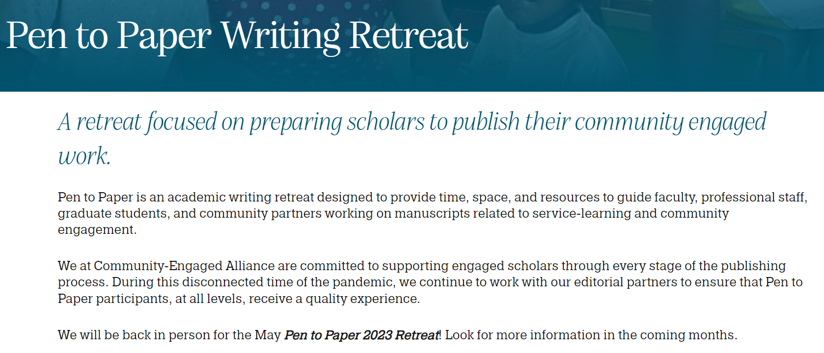
Pen to Paper: Academic Writing Retreat
Community Engaged Alliance https://communityengagedalliance.org/pen-to-paper/#:~:text=Pen%20to%20Paper%20is%20an,service%2Dlearning%20and%20community%20engagement.

Slide 37
References
Calleson, D., Kauper-Brown, J., & Seifer, S.D. (2005). Community-Engaged Scholarship Toolkit. Seattle, WA: Community-Campus Partnerships for Health. Retrieved from: https://ccph.memberclicks.net/ces-toolkit.
Doberneck, D. M. (2016). Are we there yet?” Outreach and engagement in the Consortium for Institutional Cooperation Promotion and Tenure Policies. Journal of Community Engaged Scholarship 9(1), 8-18.
Driscoll, A.,& Lynton, E. (1999). Making outreach visible: A guide for documenting professional service and outreach. Washington, DC: American Association for Higher Education.
Franz, N. K. (2011). Tips for constructing a promotion and tenure dossier that documents engaged scholarship endeavors. Journal of Higher Education Outreach and Engagement 15(3), 15-29.

Slide 38
References, Continued
Freeman, E., Gust, S., & Aloshe, D. (2009). Why faculty promotion and tenure matters to community partners. Metropolitan Universities 20(2), 87-103.
Glassick, C. , Huber, M., & Maeroff, G. (1997). Scholarship Assessed: Evaluation of the Professoriate. San Francisco, CA: Jossey Bass.
Jordan, C. (Ed.) (2007). Community engaged scholarship review, promotion, and tenure package. Peer Review Working Group. Community Engaged Scholarship for Health Collaborative, Community-Campus Partnerships for Health. Retrieved from: https://depts.washington.edu/ccph/pdf_files/CES_RPT_Package.pdf.

Slide 39
References, Continued
Seifer, S. D. (2007). Making the best case for community-engaged scholarship in promotion and tenure review. In M. Minkler & N. Wallerstein (Eds.). Community-based Participatory Research for Health: From Practice to Outcomes, 2nd edition (pp. 425-430). San Francisco, CA: Jossey-Bass.
University of Massachusetts-Boston, CLA Tenure Track Faculty Task Force. (2005). On Track Suggestions and Information for Faculty Anticipating Fourth Year or Tenure Review in the College of Liberal Arts. Retrieved from: https://www.umb.edu/academics/cla/info_for_faculty/junior_faculty_task_force.

